Slide 1
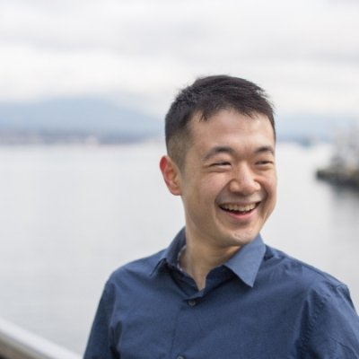
Pump it up
Capstone Project
Foundations of Data Science
Tadaaki Sun
Notes:
Introduction of myself
Data Science Problem
Executive Summary: Analytics used to identify which water points are functional or non functional and create better model than baseline

Slide 2

Notes:
Objective
Tanzania one of the poor nations with various water issues - situation is not great
need to find the fault
Develop a model that predicts non functional waterpoint, interpret results and adjust

Slide 3



http://maji.go.tz/
https://youtu.be/LR3iDNIDS80
Notes:
Data Description
Partnered with Taarifa to collect data of:
Location
Coordinates
Area (region, sub-region, ward, etc.)
Waterpoints
Nature of being created (installer, funder, etc.)
Current functionality
Duration
Dependent variable
Independent variable
Categorical
Continuous

Slide 4
54%
Notes:
Baseline model is simply functional /total
Positive values are predictive of class 1, negative is 0
Coefficient are selected to predict high probability of poor cases or low probability of good cases
Risks

Slide 5
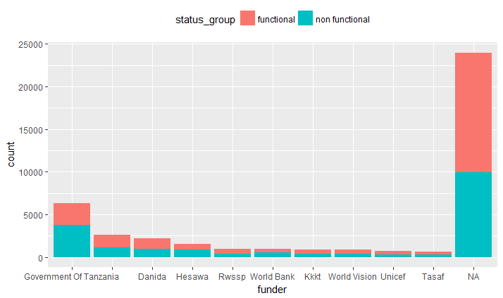
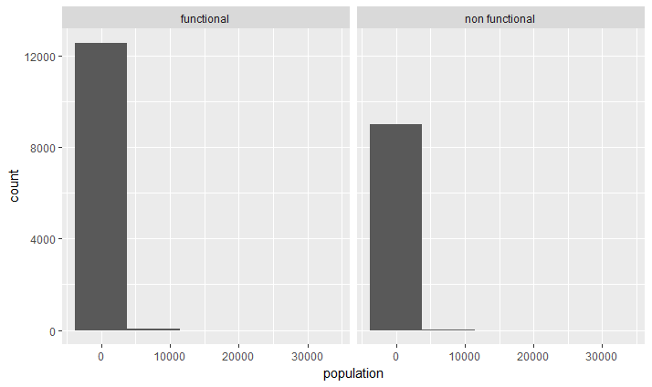
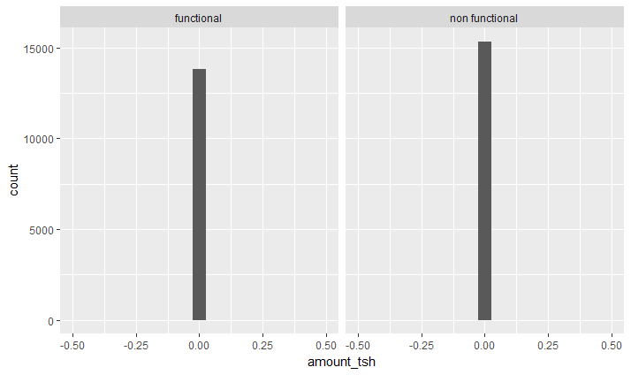
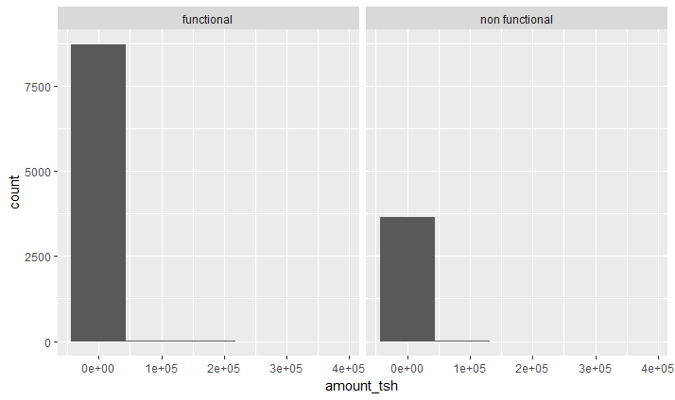
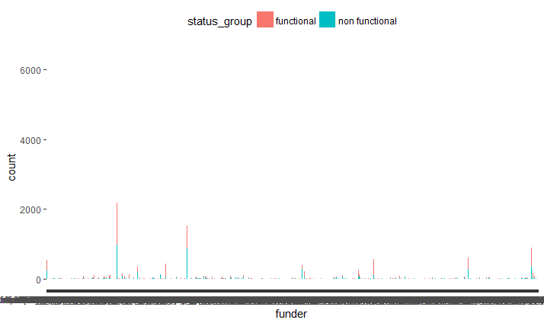
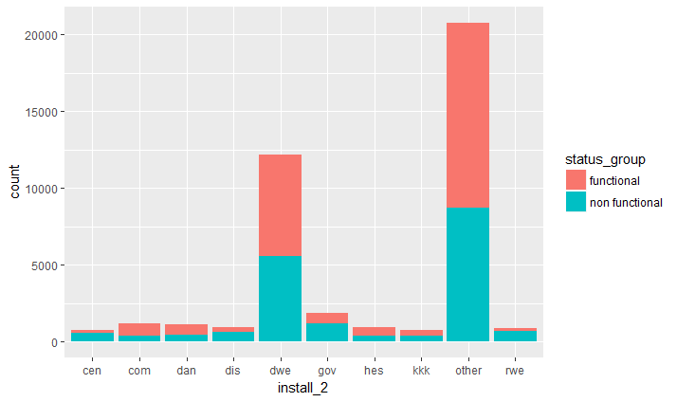
Notes:
Preliminary Data Analysis
Amount_tsh, population, funder/installer

Slide 6
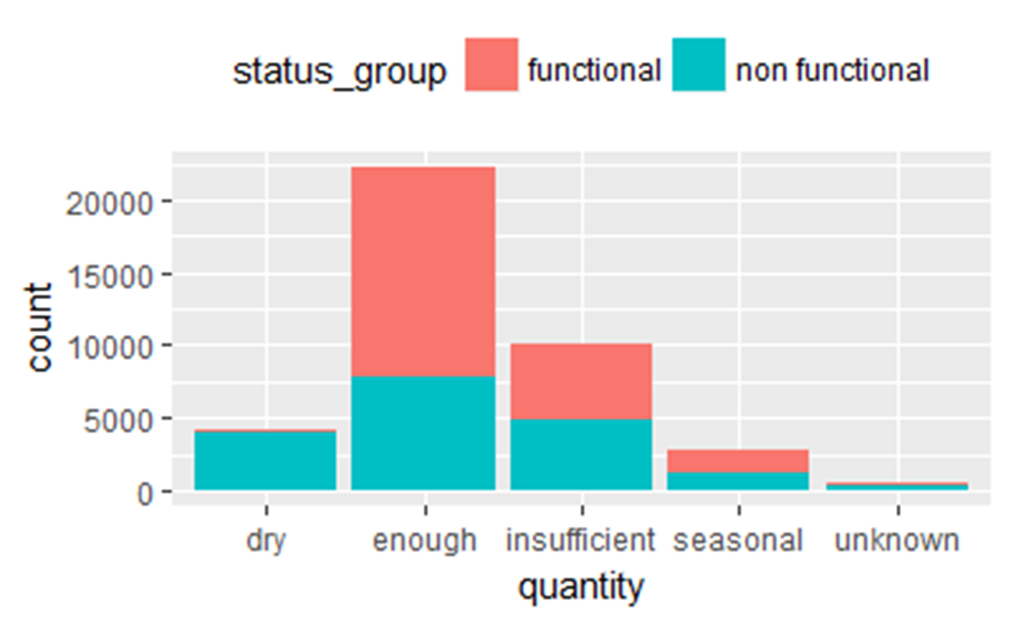
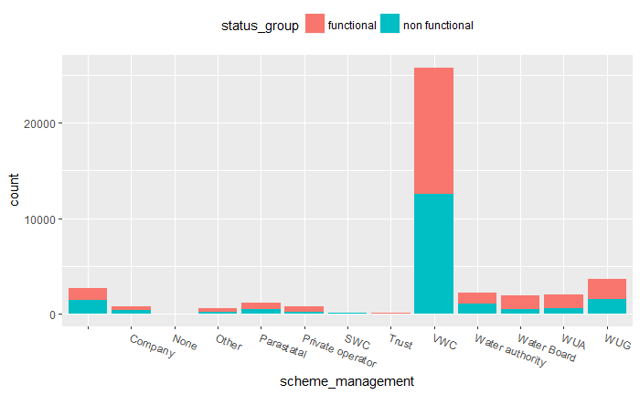
Notes:
Data Cleaning
Removing duplicates
Changing levels
Adding better features
region, public meeting, basin, permit, group of payment type, group of extraction type, group of GPS height, waterpoint type, quantity, group of scheme management and source

Slide 7
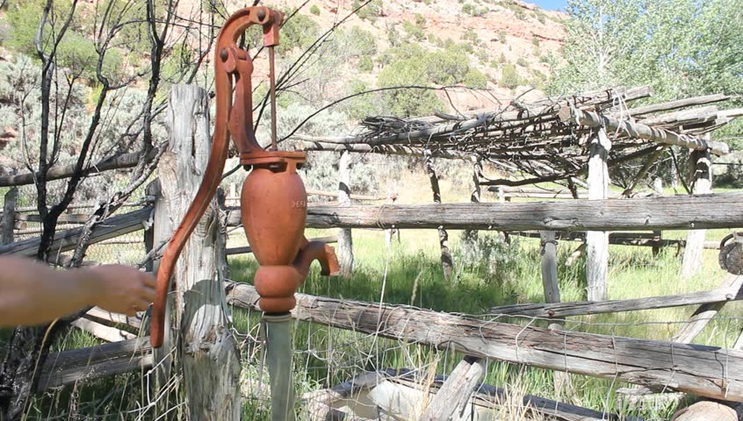
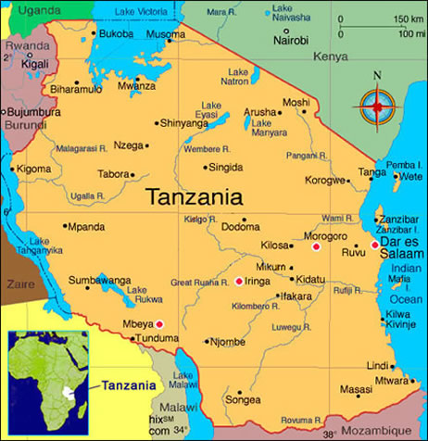
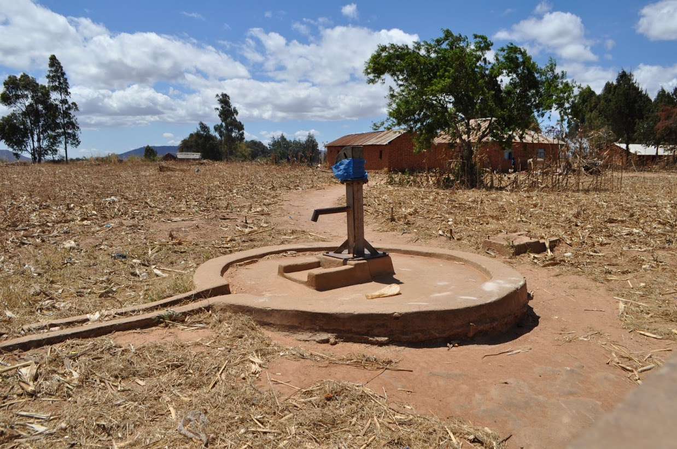
Notes:
Explaining the model – Logistic Regression
Quality, region, waterpoint_type
model is not perfect, can be improved, can have unbiased and unemotional predictors
Conclusion

Slide 8




Notes:
Future Works - LIT up Tanzania’s Community
1. Learning from the current non functional waterpoints - Go ahead and make the change based on the results shown in the model (look at quantity, region, waterpoint_type)
2. Improve efficiency of data gathering- Increase efficiency of data gathering for removed features (amount_tsh, population, installer or funder)
3. Track new data features - Create new features to improve current model , by recording information based on types on failed reason, when waterpoint was removed to calculate average lifetime use, create etc.

Slide 9

www.linkedin.com/in/tadaakisun
https://github.com/tadasun27

Slide 10


Notes:
Things Learned
1. Don’t be fancy - Don’t have to use fancy methods!
2. Don’t be afraid - There is no need to have an answer, have confidence in your answer!
3. Don’t be alone - Meet Data Scientists in your area by reaching out!

